Slide 1
What makes a BF4 player great?
BF4 Data Science Analysis – Story Telling

Slide 2
Overview
The Game
BF4 player dataset (36,000+ players)
Data Subsets (high level vs low level players; long hours vs few hours played)
Basic Analysis (scatter plot; histograms; correlation matrixes)
Further questions that need to be asked
Link to Jupyter Notebook

Slide 3
Battlefield 4
Players complete objectives with squamates to win the game
While completing objectives players need to eliminate the enemy
Players get to play different game modes that have different objectives
Players can use different weapons and vehicles
Theoretically, winning the game requires a combination of kills, vehicle usage, heals, repair, and supply collection, just like a real battlefield
However, the game stats may show that one play style triumphs the other, which is what we are trying to explore.

Slide 4
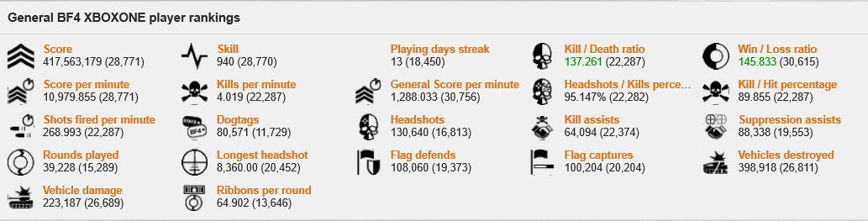
The dataset
Contains 40,000+ xbox one player performance data
Examples: player_id, score, time, kills per minute, deaths per minute, game mode, weapon usage, kit usage, vehicle usage, etc.
Link to stat site page

Slide 5
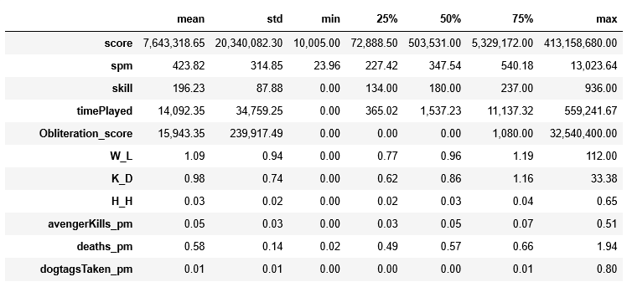
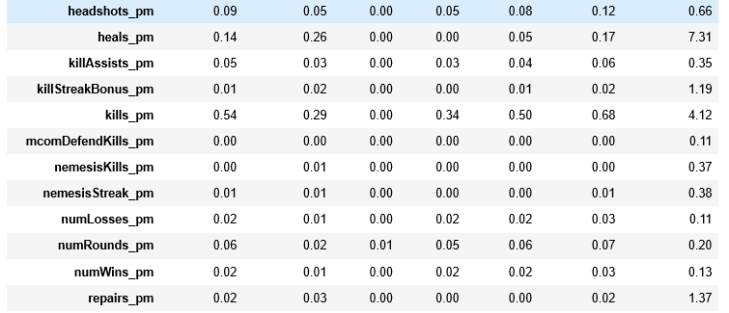
Player skill is very spread out
In the plot below we can see that skill and time of the players are very spread out. 75% of players have a skill level below 237, have less than 180 hours of gameplay and have a spm below 540. On the other hand, many top players players have over 1000 hours of play time and scores of up to hundreds of millions.

Slide 6
Sub-setting the Data
In the analysis below, we used histograms to analyze player skill level, time played, K/D, W/L, H/H. We want to see if more time spent playing the game led to the increase of these stats. Here, we've split the player base into three groups:
the generic player base;
the 1000-hour player;
the highly skilled players.

Slide 7
More hours doesn’t mean more skillful
In the charts in the next page, we compare the stats of 1000 hour player vs generic players.
We can see improvements made by the 1000 hour players in terms of skill, K/D, W/L.
However, we can see that headshots/hits doesn't seem to have improved.
In fact, based on the data in the chart, in order to gain improved wins and kills, 1000 hour players are making less headshots within the game.

Slide 8
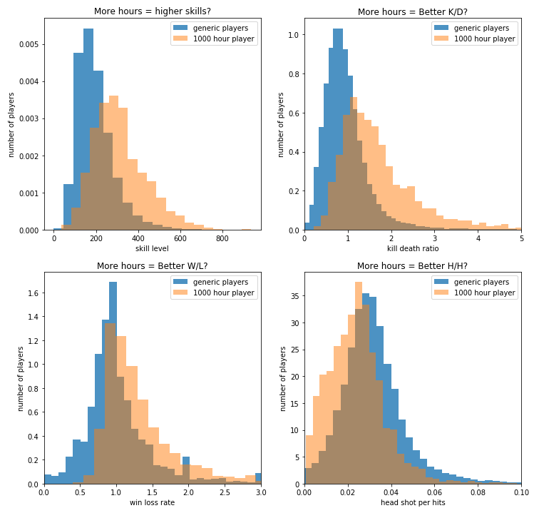

Slide 9
The game is balanced with good matchmaking
In the second series of charts, we see that high skilled players in general seems to be making less progress in terms of W/L.
this could be that the game is auto matching high skilled players against each other to make sure the game is well-balanced.
We do see that for high skilled players, an improvement in H/H which means that H/H does play a part in improve in skill level and K/D, but not as much as one would think in terms of W/L.

Slide 10
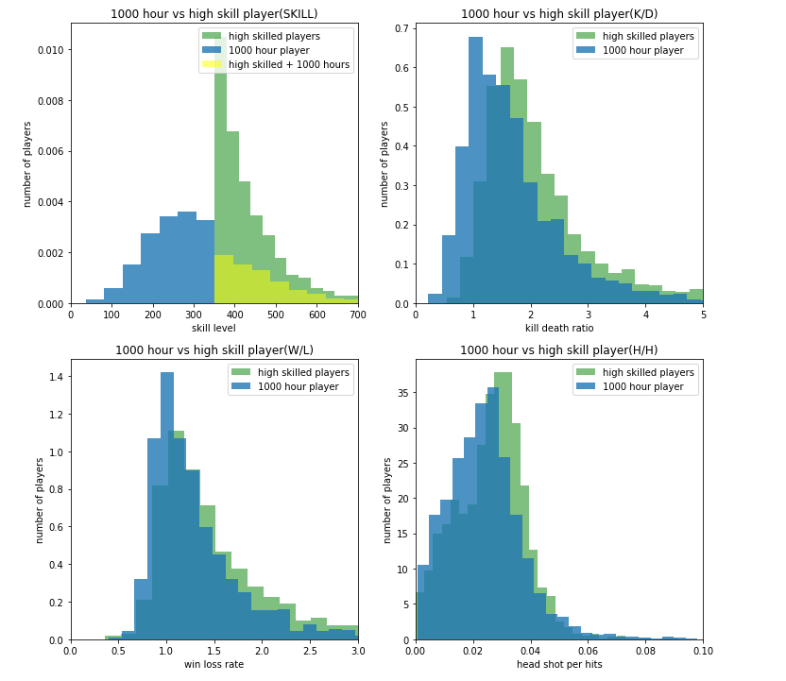

Slide 11

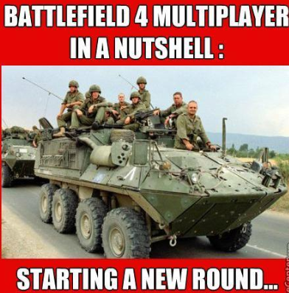
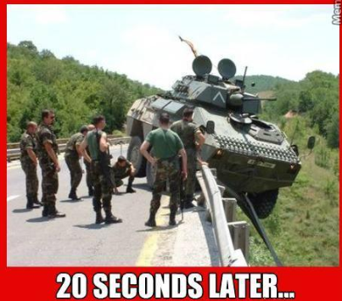
Noob vs Expert, how are they different?

Slide 12
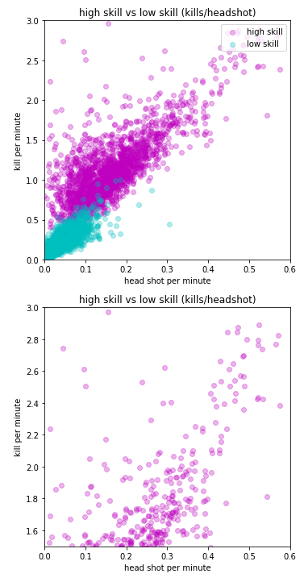
Most players can’t or don’t make consistent headshots
In the plots below, we compare the relations between "kills/minute" vs "headshots/minute", and "kills/minute" vs "deaths/minute".
We compare the data of two groups, players with high of over 350 and players with low skills below 100.
We can see from the data that low skill players have trouble making kills and getting head shots. Whereas high skilled player can make significant more headshots and kills.
While it does seem that there is a linear relation between headshots and kills made, there are still a significant amount of players that are making kills with less headshots per minute

Slide 13
If you are new to the game, focus on body shots or vehicle kills
Headshots per effective hit ratio seems to negatively affect the overall score and score per minute of the player
In combination with the previous conclusion we got about high-level players getting more kills with headshots…
We can see that the majority of BF4 players rely on body shots and instead of headshots to make kills.
The theory a kill requires multiple headshots, which only the players with on the highest skill level can achieve.

Slide 14
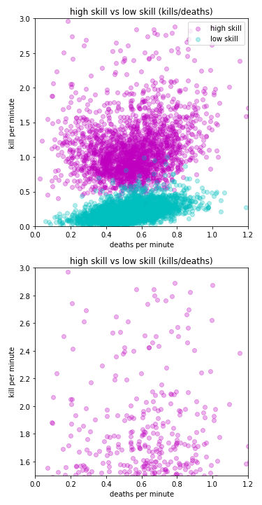
Death is inevitable, better to not think about it and ramp up more kills
On the other hand, if we look at survivability, which is counted using deaths per minute
We can see that being able to survive doesn't seem to contribute that much to the ability to make kills
The only difference here is that high skilled players kill more people, that’s all.
Players of all level die quickly within 1 minute, either being killed by another player or from randomly falling to their death.

Slide 15
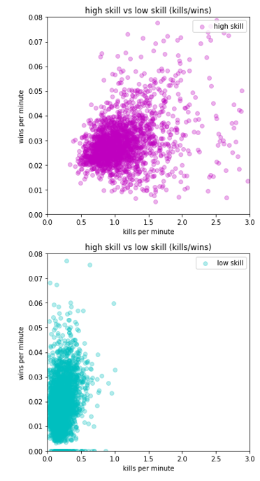
Auto matchmaking - the glass ceiling of higher win rates
High level players are able to make significantly more kills than low level players
However, their high skill level pits them against other high level players, which reduces their chances of winning
This does show that in order to move to high level ranking, you need to make more kills
But don’t expect to win more

Slide 16
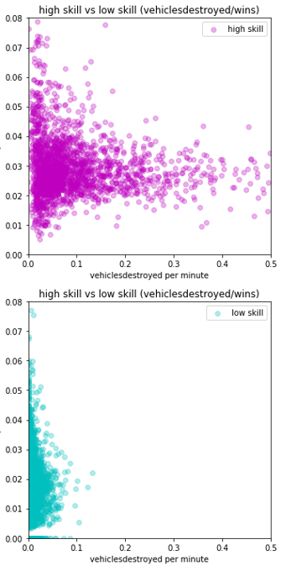
Destroy more vehicles that’s what the experts say
Highly skilled players are more likely to target and destroy vehicles than low level players
Though the win rate is capped, high level players understand that destroying vehicles are the key to winning
However, win rate doesn’t improve due to auto matchmaking

Slide 17
What a correlation matrix can tell us
A few conclusions we can draw are:
the more time spent playing the game, the higher score you'll get;
conquest mode gives the most score per minute;
headshots, assists both helps with generating effective kills per minute, meaning that the game rewards players on both skill and teamplay;
nemesis kills, which means killing a player repeatedly without being killed by that player, seems to contribute to kills per minute as well,
which means within a matchup, there might be a low-level players that is unlucky enough to be picked on by the same high-level player;
If you’re new to the game, be prepared for the occasional gameplay bullying

Slide 18
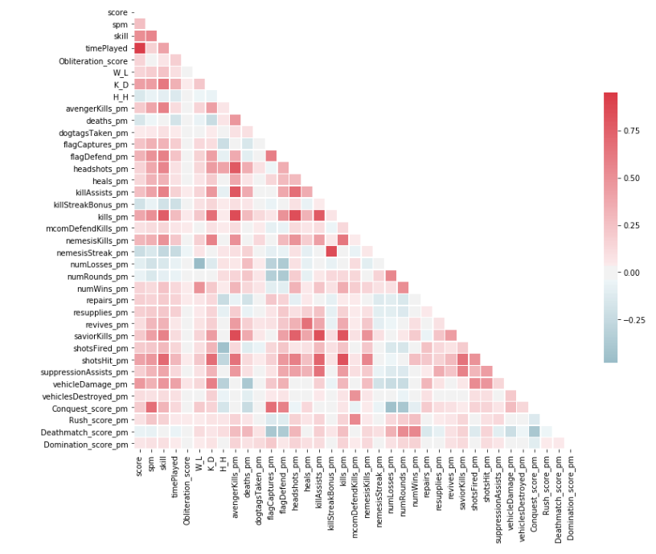

Slide 19



What we’d like to know next
What kind of weapons do players use
What kind of vehicles do players use
What are the characteristics of players who frequently play different game modes

